Slide 1

Chapter 2
Conducted and Radiated Media
Jill West | Curt M. White, Data Communications and Computer Networks: A Business User’s Approach, 9th Edition. © 2023 Cengage. All Rights Reserved. May not be scanned, copied or duplicated, or posted to a publicly accessible website, in whole or in part.

Slide 2
After reading this chapter, you should be able to:
Identify common cabling standards
Compare types of network cables
Compare wireless network technologies
Evaluate the best media for network connections

Slide 3
Introduction
The world of computer networks would not exist if there were no medium by which to transfer data
The two major categories of media include:
Conducted (wired) media
standards for cables and connectors
Radiated (wireless) media
standards for transmission
Media selection criteria

Slide 4
Cabling Standards (1 of 3)
The need for agreement between network devices starts with the definition of standards for physical equipment
Components:
electrical components
mechanical components
functional components
procedural components

Slide 5
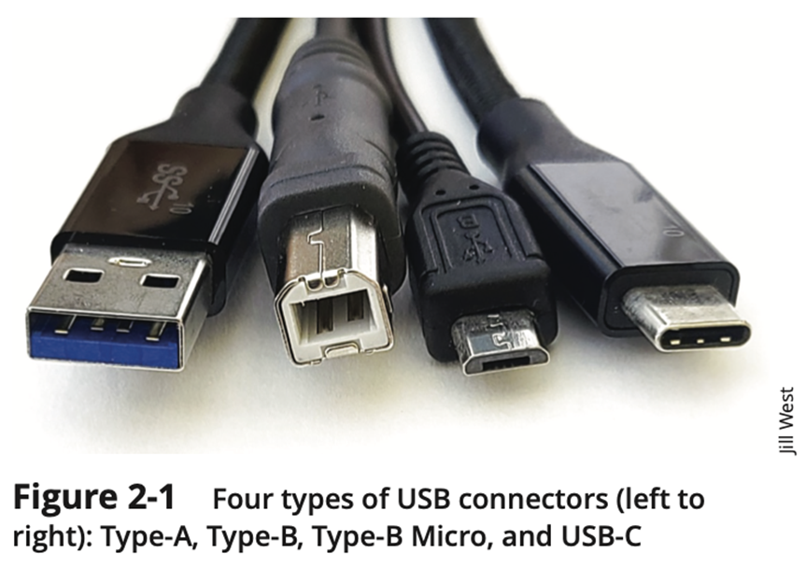
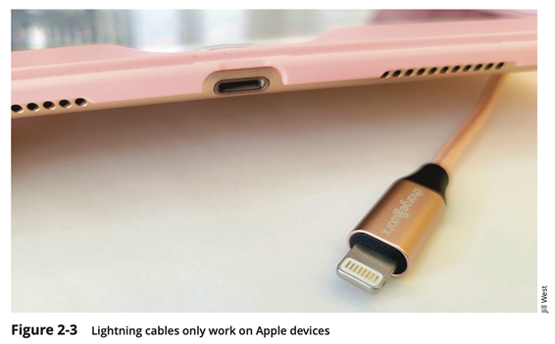
Cabling Standards (2 of 3)
Personal Area Network (PAN) Connector Standards
USB Type-A
USB Type-B
USB Type-B Micro
USB-C
Lightning

Slide 6
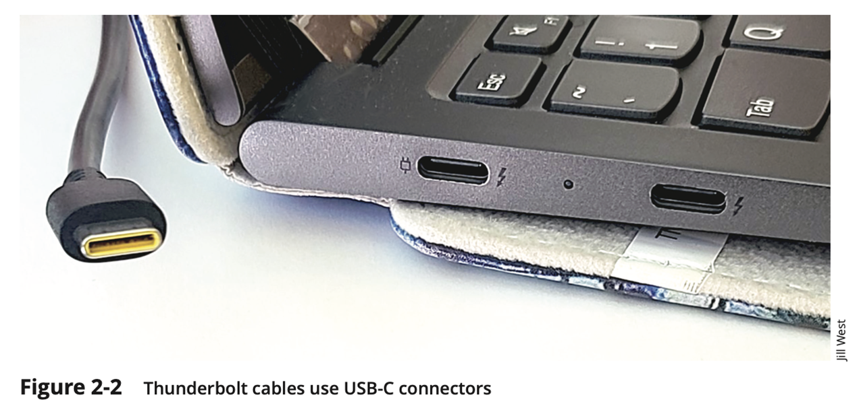
Cabling Standards (3 of 3)
Personal Area Network (PAN) Protocol Standards:
USB 1.0
USB 2.0
USB 3.0
Thunderbolt

Slide 7
Twisted Pair Wire (1 of 5)
One or more pairs of single conductor wires that have been twisted around each other
Twisted pair wire is classified by category. Twisted pair is currently Category 1 through Category 8, although Categories 1, 2, 3, and 4 are nearly obsolete
Twisting the wires helps to eliminate electromagnetic interference between the two wires
Shielding can further help to eliminate interference

Slide 8
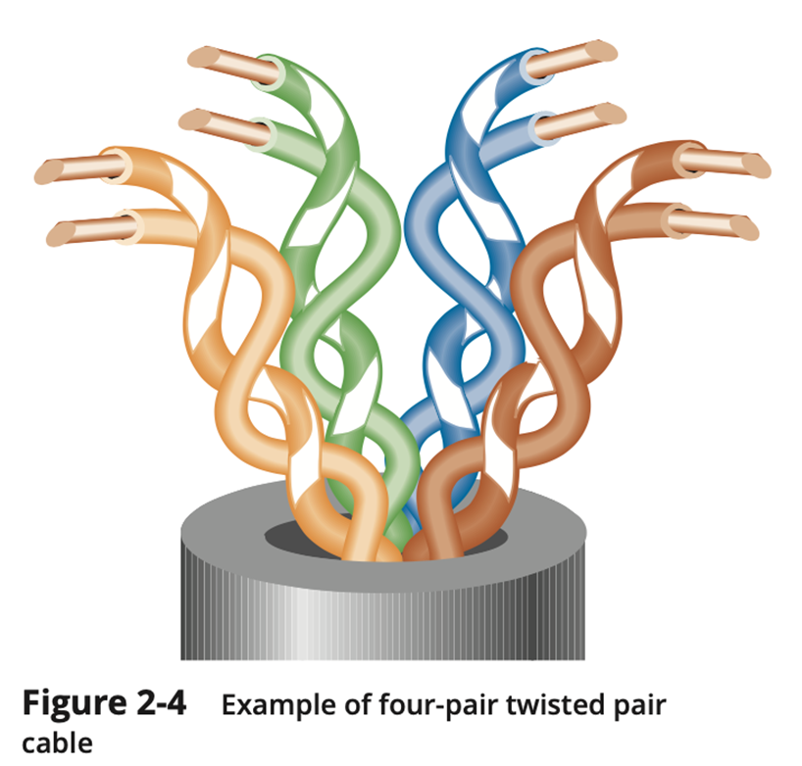
Twisted Pair Wire (2 of 5)

Slide 9
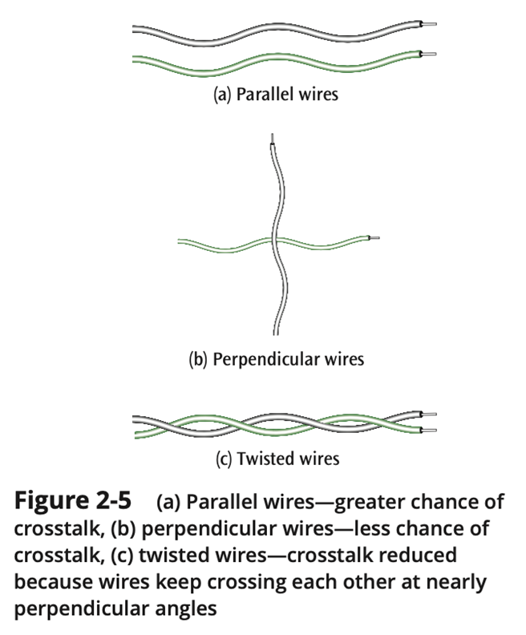
Twisted Pair Wire (3 of 5)

Slide 10
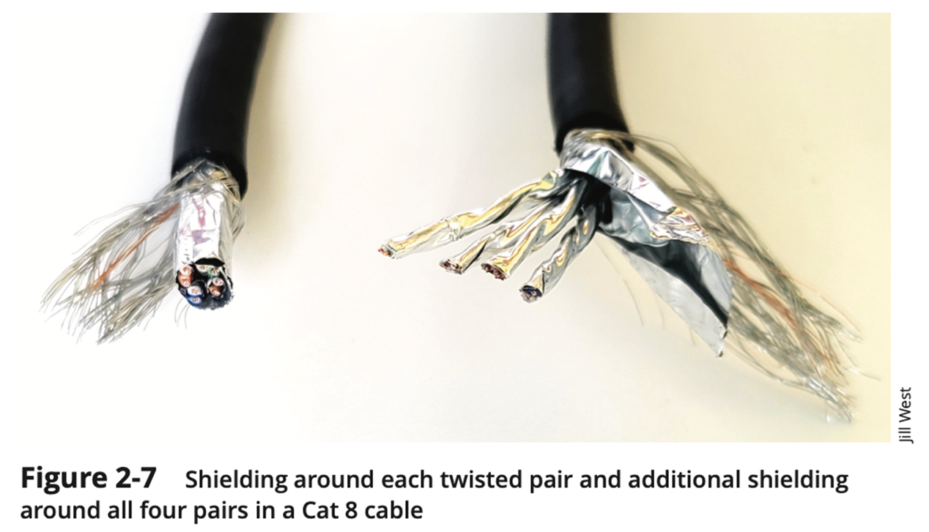
Twisted Pair Wire (4 of 5)

Slide 11
Twisted Pair Wire (5 of 5)
Table 2-1 Characteristics of twisted pair cables
UTP Category | Typical Use | Maximum Data | Maximum Transmission Range | Advantages | Disadvantages
Cat 5 | LANs | 100 Mbps (100 MHz) | 100 m (328 ft) | Inexpensive, easy to install and interface | Security, noise, obsolete
Cat 5e | LANs | 250 Mbps per pair (125 MHz) | 100 m (328 ft) | Inexpensive, easy to install and interface, supports Gigabit Ethernet | Security, noise
Cat 6 | LANs | 250 Mbps per pair (250 MHz) | 100 m (328 ft) | Higher data rates than Cat 5e, less noise | Security, noise
Cat 6a | LANs | 500 MHz | 100 m (328 ft) | Support for 10 Gig Ethernet, increased shielding | Security, noise
Cat 7 | Backbone connections | 600 MHz | 100 m (328 ft) | 100 Gig Ethernet at very short distances (15 m) | Security, cost, requires special connectors
Cat 7a | Backbone connections | 1000 MHz | 100 m (328 ft) | Same as Cat 7, plus additional shielding | Security, cost, requires special connectors, thicker and more difficult to install
Cat 8 Class I and Class II | Backbone connections | 2000 MHz | 30 m (98 ft) | 25 Gig and 40 Gig support at longer distances than Cat 7; Cat 8 Class I uses standard connectors | Security, cost

Slide 12
Twisted Pair Summary
Most common form of wire
Relatively inexpensive
Easy to install
Carries high data rates (but not the highest)
Can suffer from electromagnetic noise
Can be easily wire-tapped
Comes in shielded and unshielded forms

Slide 13
Coaxial Cable (1 of 3)
A single wire wrapped in a foam insulation surrounded by a braided metal shield, then covered in a plastic jacket.
Cable comes in various thicknesses
Baseband coaxial technology uses digital signaling in which the cable carries only one channel of digital data
Broadband coaxial technology transmits analog signals and is capable of supporting multiple channels

Slide 14
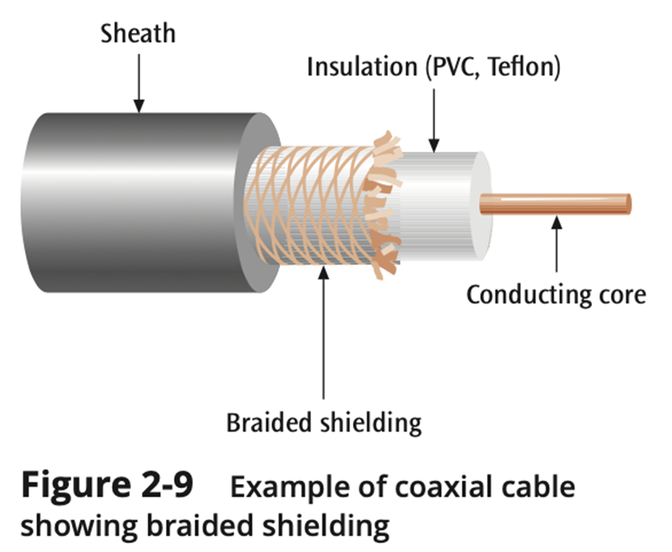
Coaxial Cable (2 of 3)

Slide 15
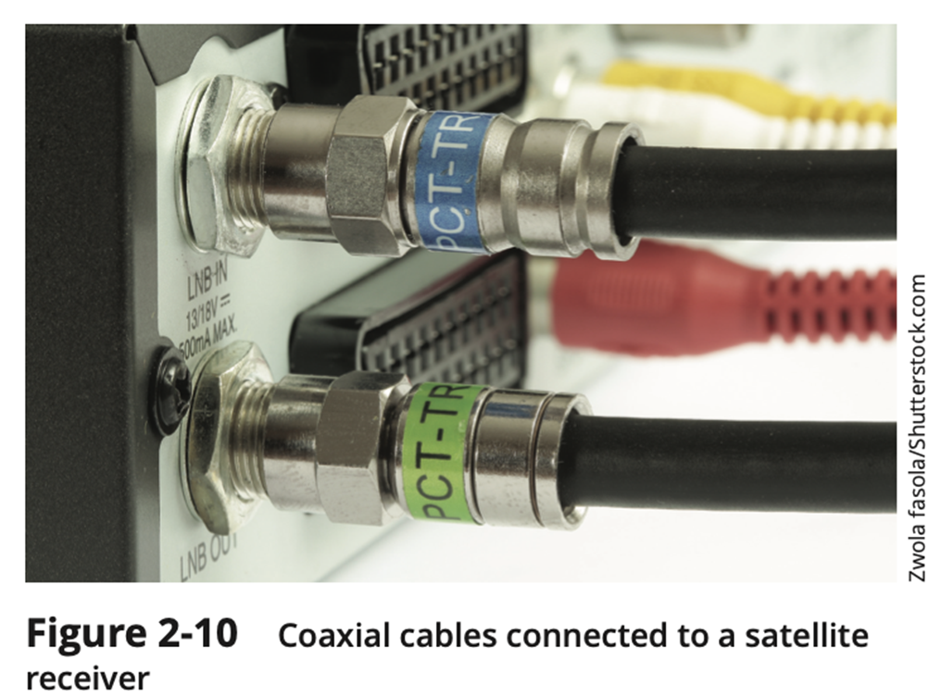
Coaxial Cable (3 of 3)

Slide 16
Coaxial Cable Summary
A single wire surrounded by a braided shield
Because of shielding, can carry a wide bandwidth of frequencies
Thus, is good with applications such as cable television
Not as easy to install as twisted pair
More expensive than twisted pair

Slide 17
Fiber-Optic Cable (1 of 7)
A thin glass cable approximately a little thicker than a human hair surrounded by a plastic coating and packaged into an insulated cable
A photo diode or laser generates pulses of light which travel down the fiber optic cable and are received by a photoreceptor

Slide 18
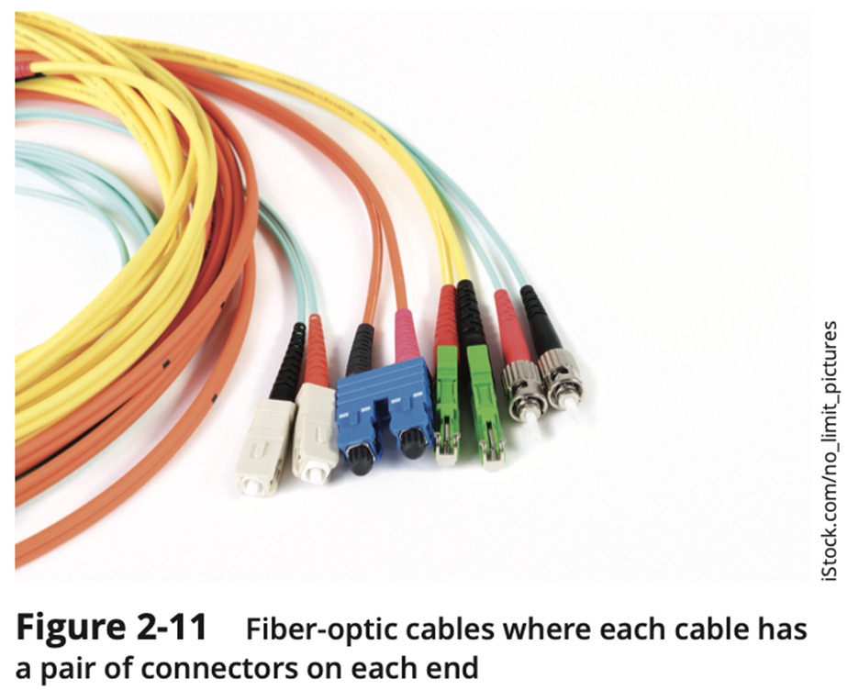
Fiber-Optic Cable (2 of 7)

Slide 19
Fiber-Optic Cable (3 of 7)
Fiber-optic cable is capable of supporting millions of bits per second for 1000s of meters
Thick cable (62.5/125 microns) causes more ray collisions, so you have to transmit slower. This is step index multimode fiber. Typically use LED for light source, shorter distance transmissions
Thin cable (8.3/125 microns) – very little reflection, fast transmission, typically uses a laser, longer transmission distances; known as single mode fiber

Slide 20
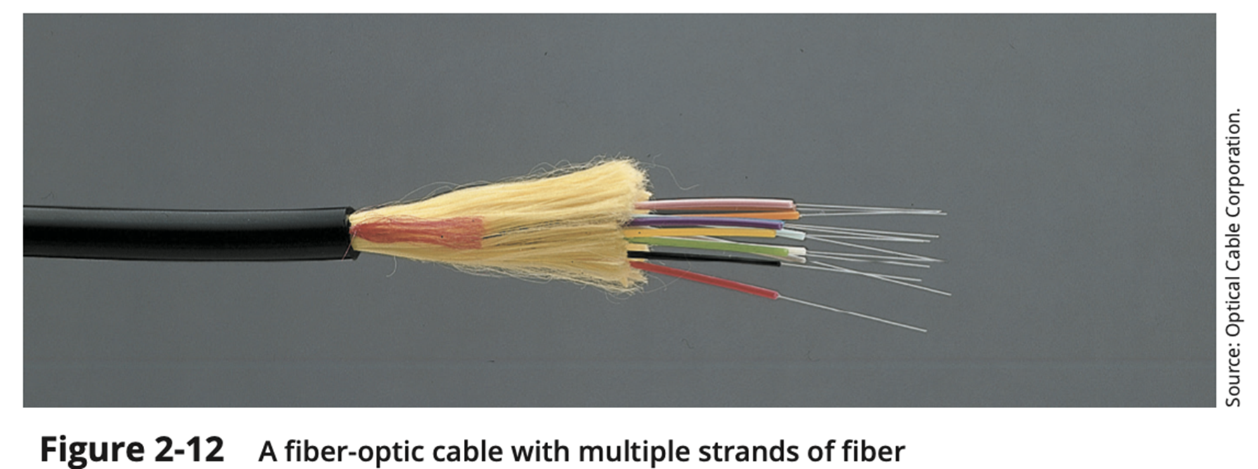
Fiber-Optic Cable (4 of 7)

Slide 21
Fiber-Optic Cable (5 of 7)
Fiber-optic cable is susceptible to reflection (where the light source bounces around inside the cable) and refraction (where the light source passes out of the core and into the surrounding cladding)
Thus, fiber-optic cable is not perfect either. Noise is still a potential problem

Slide 22
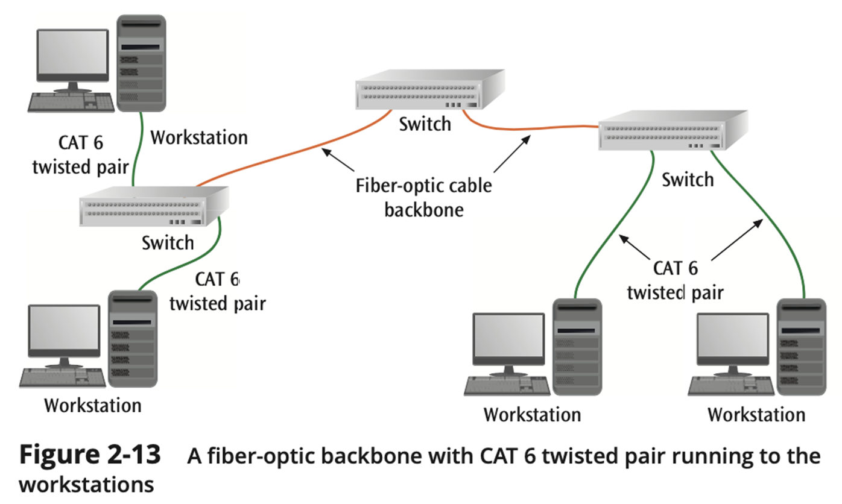
Fiber-Optic Cable (6 of 7)

Slide 23
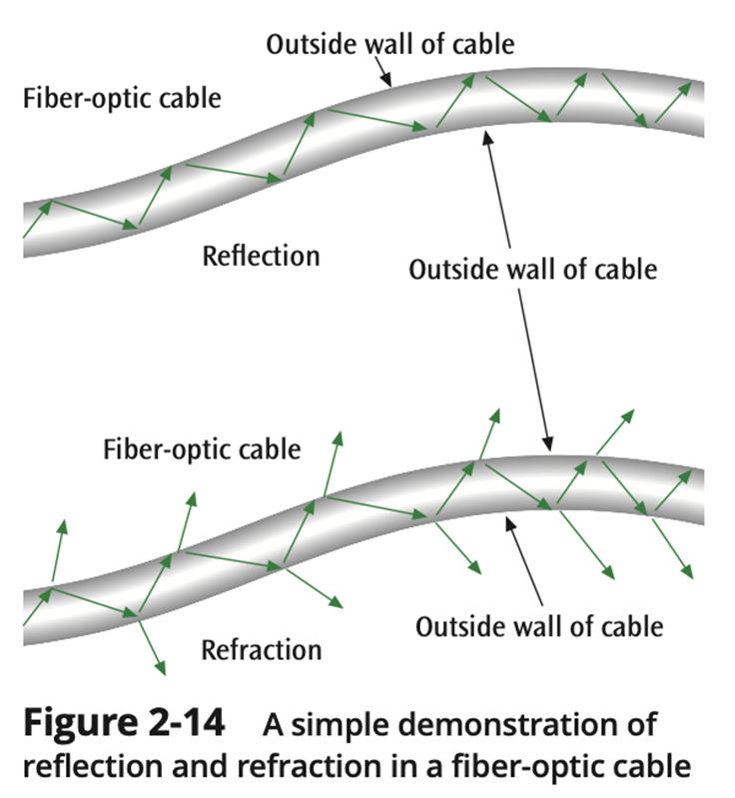
Fiber-Optic Cable (7 of 7)

Slide 24
Fiber-Optic Cable Summary
Fiber optic cable can carry the highest data rate for the longest distances
Initial cost-wise, more expensive than twisted pair, but less than coaxial cable
But when you consider the superiority of fiber, initial costs outweighed by capacities
Need two fibers for a round-trip connection
Not affected by electromagnetic noise and cannot be easily wiretapped, but still noise

Slide 25
Conducted Media
Table 2-4 A summary of the characteristics of conducted media
Type of Conducted Medium | Typical Use | Maximum Data Rate | Maximum Transmission Range | Advantages | Disadvantages
Twisted pair Cat 5, 5e, 6, 6a, 7, 7a, 8 | LANs | 100 Mbps-100 Gbps | 100 m (328 feet) | Inexpensive, versatile | Noise, security
Coaxial cable | Cable TV, long-distance telephone, short-run computer system links | 1 Gbps | 5-6 kilometers (3-4 miles) (at lower data rates) | Low noise, multiple channels | Security
LED fiber optic | Data, video, audio, LANs | 10 Gbps | 300 meters (approx. 1000 feet) | Secure, high capacity, low noise | Expensive interface but decreasing in cost
Laser fiber optic | Data, video, audio, LANs, WANs, MANs | 100s Gbps | 100 kilometers (approx. 60 miles) | Secure, high capacity, very low noise | Expensive interface

Slide 26
Radiated Media on LANs (1 of 2)
Radio, satellite transmissions, and infrared light are all different forms of electromagnetic waves that are used to transmit data
Technically speaking – in wireless transmissions, space is the medium
Note in the following figure how each source occupies a different set of frequencies

Slide 27
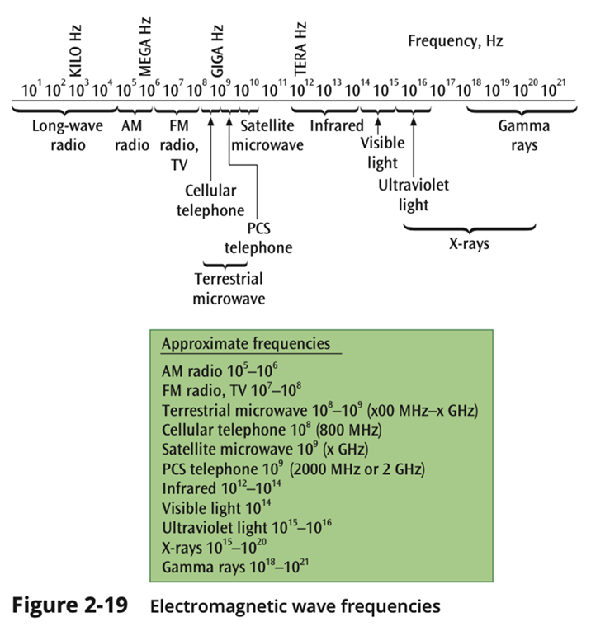
Radiated Media on LANs (2 of 2)

Slide 28
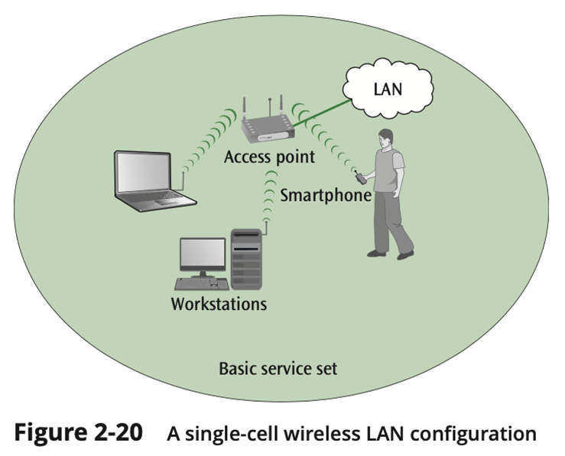
Wi-Fi (1 of 4)
Wireless LAN, often referred to by the trademarked term Wi-Fi (wireless fidelity)
Constituents:
Wireless clients
desktops, laptops, mobile devices, etc.
A wired LAN
Access point, a.k.a, wireless router

Slide 29
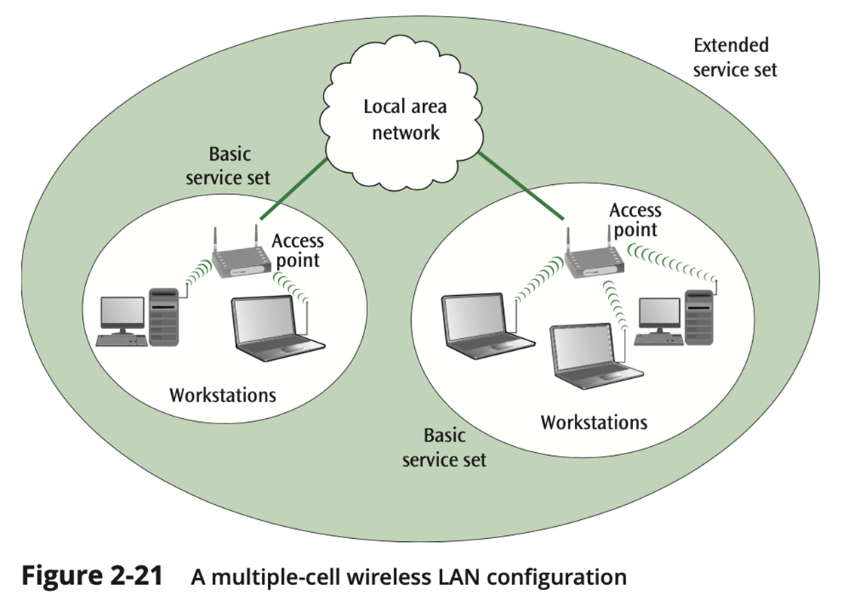
Wi-Fi (2 of 4)

Slide 30
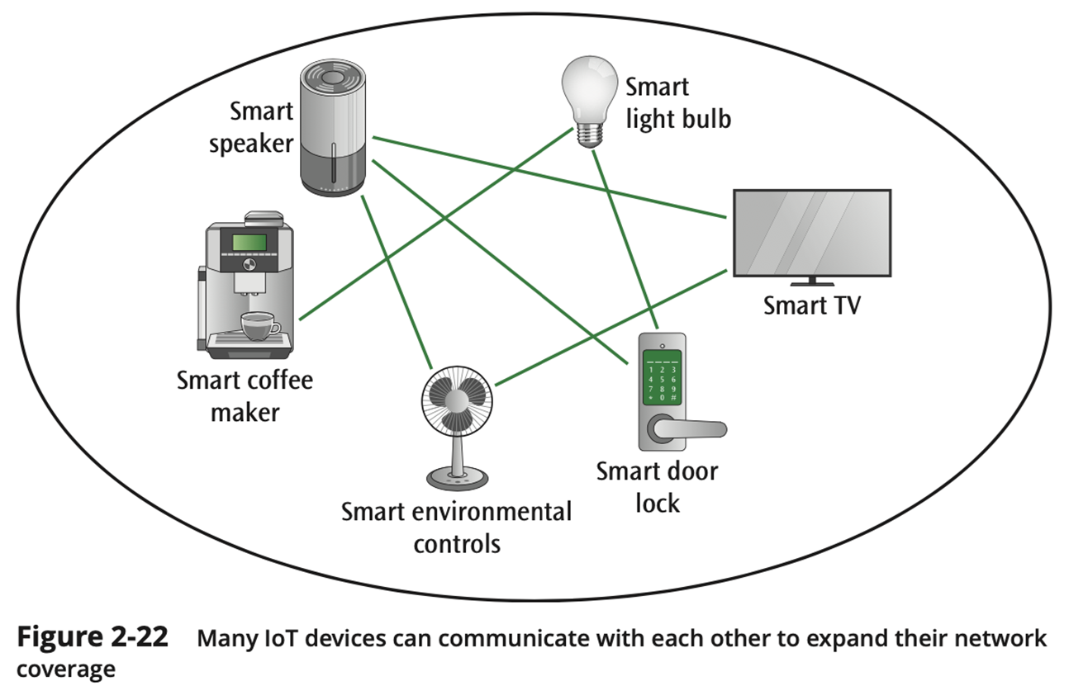
Wi-Fi (3 of 4)

Slide 31
Wi-Fi (4 of 4)
Table 2-5 Technical details for 802.11 wireless standards
Standard | Frequency Band | Maximum Theoretical Throughput | Geographic Range
802.11b (Wi-Fi 1) | 2.4 GHz | 11 Mbps | 100 m
802.11 a (VVi-Fi 2) | 5 GHz | 54 Mbps | 50 m
802.11g (Wi-Fi 3) | 2.4 GHz | 54 Mbps | 100 m
802.11 n (Wi-Fi 4) | 2.4 GHz or 5 GHz | 600 Mbps | Indoor: 70 m Outdoor: 250 m
802.11ac (Wi-Fi 5) | 5 GHz | Wave 1 (3 data streams): 1.3 Gbps Wave 2 (4 data streams): 3.47 Gbps Wave 3 (8 data streams): 6.93 Gbps | Indoor: 70 m Outdoor: 250 m
802.11 ax (Wi-Fi 6 and Wi-Fi 6E) | 2.4 GHz or 5 GHz or (Wi-Fi 6E only) 6 GHz | 9.6 Gbps | Indoor: 70 m Outdoor: 250 m

Slide 32
Bluetooth (1 of 2)
Bluetooth protocol was created to unify separate nodes as mobile devices, computers, and accessories within a smaller range than the Wi-Fi standards
A wireless technology that uses low-power, short-range radio frequencies to communicate between devices
Bluetooth can transmit through solid, non-metal objects

Slide 33
Bluetooth (2 of 2)
Its typical link range is from 10 cm to 10 m, but can be extended to 100 m by increasing the power
Class 1 devices: transmission of data up to 100 meters
computers
Class 2 devices: transmission of data up to 10 meters
mobile devices, headphones, etc.
Class 3 devices: transmission of data up to a couple of meters
mouses and keyboards

Slide 34
Zigbee (1 of 2)
New wireless technology designed for data transmission between smaller, often embedded, devices
Low data transfer rates (20–250 Kbps) and corresponding low power consumption
Bluetooth is best at replacing cables for short distances, while Zigbee is good at sending low-speed and low-power signals over short to medium distances

Slide 35
ZigBee (2 of 2)
Based upon IEEE 802.15.4 standard
Ideal for heating, cooling, security, lighting, and smoke and CO detector systems
ZigBee can use a mesh design – a ZigBee-enabled device can both accept and then pass on ZigBee signals

Slide 36
Ultra-Wideband (1 of 2)
Ultra-wideband
UWB not limited to a fixed bandwidth but broadcasts over a wide range of frequencies simultaneously
Many of these frequencies are used by other sources, but UWB uses such low power that it “should not” interfere with these other sources
Can achieve speeds up to 100 Mbps but for small distances such as wireless LANs

Slide 37
Ultra-Wideband (2 of 2)
Ultra-wideband (continued)
Proponents for UWB say it gets something for nothing, since it shares frequencies with other sources. Opponents disagree
Cell phone industry against UWB because CDMA most susceptible to interference of UWB
GPS may also be affected
One solution may be to have two types of systems – one for indoors (stronger) and one for outdoors (1/10 the power)

Slide 38
Infrared Transmissions
Transmissions that use a focused ray of light in the infrared frequency range
Very common with remote control devices, but can also be used for device-to-device transfers, such as PDA to computer

Slide 39
Near-Field Communications
Very close distances or devices touching
Magnetic induction (such as radio frequency ID) used for transmission of data
Commonly used for data transmission between cellphones (non-Apple devices)

Slide 40
Summary of Wireless LAN Technologies
Table 2-6 Summary of wireless media
Type of Wireless Medium | Typical Use | Maximum Data Transfer Rate | Typical transmission Range | Advantages | Disadvantages
Wi-Fi | Local area networks | 10 Gbps | 45-90 meters (150-300 feet) | Relative ease of use | Several standards
Bluetooth | Short-distance transfer | 2 Mbps | A few feet to 100 meters (328 feet) depending on device class | Universal protocol | Limited distances
Zigbee | Short-to-medium distance, low- speed transfers | 250 Kbps | Almost unlimited distance (mesh) | Low power | Low transfer speeds
IR | Short-distance data transfer | Varies by protocol used | 10 meters (33 feet) | Fast, inexpensive, secure | Short distances, line of sight
UWB | Short-distance, high-speed transfers; location discovery | 100 Mbps | 100 meters (328 feet) | High speed, not restricted to fixed frequencies | May interfere with other sources
NFC | Very short distance data transfer | 424 Kbps | About 4 cm | High-speed connections; allows for passive devices with no internal power supply | Very limited distance

Slide 41
Media Selection Criteria
Cost
Speed
Distance and expandability
Environment
Security

Slide 42
Cost
Different types of costs
Initial cost – what does a particular type of medium cost to purchase? To install?
Maintenance / support cost
ROI (return on investment) – if one medium is cheaper to purchase and install but is not cost effective, where are the savings?

Slide 43
Speed
Two different forms of speed:
Propagation speed – the time to send the first bit across the medium
This speed depends upon the medium
Airwaves and fiber are speed of light
Copper wire is two thirds the speed of light
Data transfer speed – the time to transmit the rest of the bits in the message
This speed is measured in bits per second

Slide 44
Expandability and Distance
Certain media lend themselves more easily to expansion
Don’t forget right-of-way issue for conducted media and line-of-sight for certain wireless media

Slide 45
Environment
Many types of environments are hazardous to certain media
Electromagnetic noise
Scintillation and movement
Extreme environmental conditions

Slide 46
Security
If data must be secure during transmission, it is important that the medium not be easy to tap
Make the wire impervious to electromagnetic wiretapping
Encrypt the signal going over the medium

Slide 47
Summary (1 of 2)
All data communication media can be divided into two basic categories: conducted (wired) media, and radiated (wireless) media
Cabling standards define both physical and logical (protocols) standards
The three types of conducted media are twisted pair, coaxial cable, and fiber-optic cable
Twisted pair and coaxial cable are both metal wires and are subject to electromagnetic interference
Fiber-optic cable is a glass wire and is impervious to electromagnetic interference

Slide 48
Summary (2 of 2)
Several basic groups of wireless media exist: Wi-Fi, Bluetooth, ZigBee, ultra-wideband, near-field communications, and infrared
Each of the wireless technologies is designed for specific applications
When trying to select a particular medium for an application, it helps to compare the different media using these criteria: cost, speed, expandability and distance, environment, and security

